Slide 1
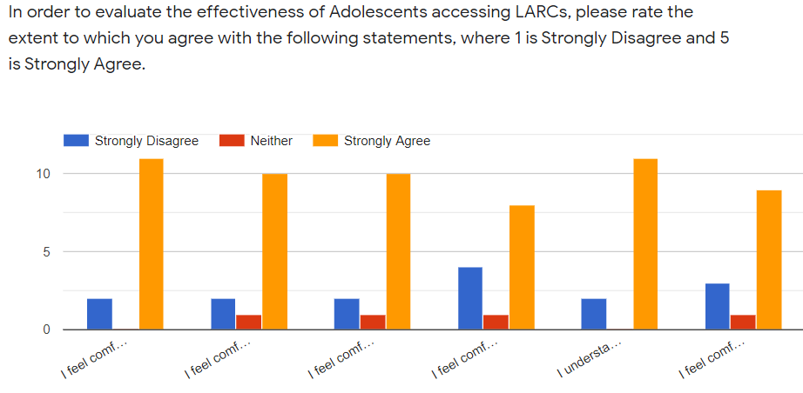
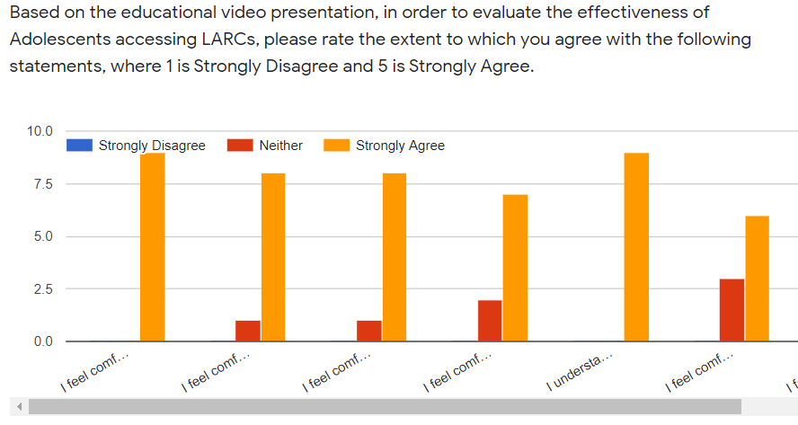
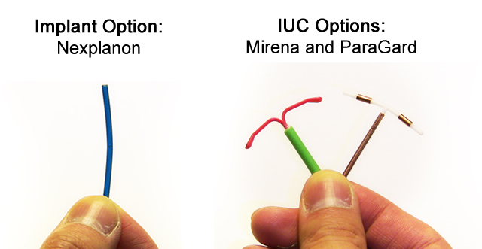
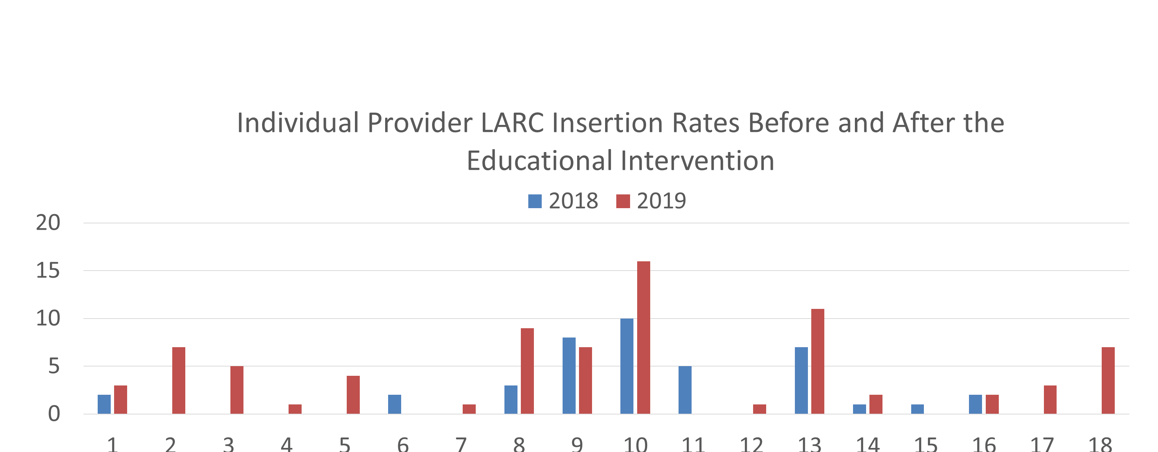
Navigating Obstacles: Clinical and Ethical Barriers to Long Acting Reversible Contraception (LARC) in Adolescents
Terri Page, DNP, APRN, WHNP-BC¹, Nancy Jallo, PhD, FNP-BC, WHNP-BC²; Kimberly, Galgano, MD³; Courtney Pate, PhD, MSN, FNP-BC⁴
Virginia Commonwealth University– DNPs of Color
¹ Virginia Women’s Center, Richmond, VA, ² Virginia Commonwealth University, Richmond, VA, ³ Virginia Women’s Center, Richmond, VA, ⁴ Baltimore Health Department, Baltimore, MD
Background
In the U.S. adolescent pregnancy is a major public health concern. Each year over 700,000 female adolescents ages15-19 become pregnant and 82% report that their pregnancy was unplanned. Long Acting Reversible Contraception (LARC)-intrauterine devices (IUD) and subdermal implants are safe and effective yet remain underused in this population. LARC failure rate is less than 1% and only 4.5% of adolescents choose LARC methods
Purpose
This quality improvement project aims to evaluate the effectiveness of an evidence based (EB) educational intervention to improve the LARC use in adolescents among providers in an Obstetrical/Gynecology (OB/GYN) practice.
Research Question
In the adolescent population who are seeking birth control, how does provider education in LARC use affect adolescents’ selection of LARC as a viable birth control option?
Methods
Education and skills building used by providers to reinforce evidence based LARC best practices.
Sample (N=17) OB/GYN providers
Pre and Post training surveys used to analyze provider knowledge and skills building
LARC insertion rates and satisfaction scores measured before and after interventions
DNP LARC Tool Kit-pamphlets, guidelines, and pre and post LARC educational video and power point presentation
Likert Scale Pre and Post surveys
LARC and Adolescent educational video power point presentation to address concerns
LARC skills training stations with IUD and Nexplanon models
Implications
Based on the conclusions
Limitations
Limitations surround the small sample size and scant qualitative data. ,
Next Steps
Applying evidenced based LARC methods best practices to the clinical area is paramount in the provision of LARCs in adolescents.
Continue research on provider education on the evidence for translation into clinical practice is warranted.
QR Code
Acknowledgements
A special gratitude goes to my project ream members: Nancy Jalllo, Dr. Kimberly Galgano, and Dr. Courtney Pate..
A special thank you goes to Dr. Joi Williams and LaTasha Watson for their statistical analysis.
This research did not receive any specific grant from funding agencies in the public, commercial or not for profit sectors.
Contact: paget421@gmail.com
Conclusion
This project demonstrated that educating providers on LARC best practices enhanced the provision of LARC methods in adolescents.
Project Dissemination is encouraged to educate providers on LARC best practices, thereby decreasing adolescent unintended pregnancy rate.
Figure 1. Presurvey and postsurvey scores
Figure 2. Presurvey and postsurvey scores
 | 2018 | 2019
Total | 48 | 75
Nexplanon | 25 | 28
IUD | 23 | 47
Figure 3. Adolescent LARC Insertions Office Wide Visits 2018 and 2019
Figure 4. Individual provider LARC insertion rates before and after intervention

