Slide 1
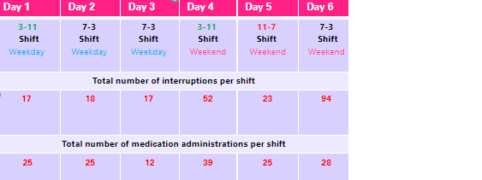
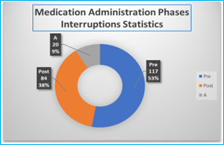
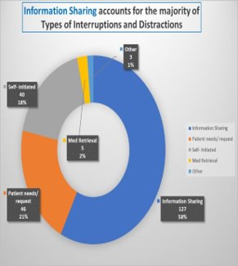
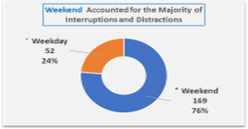
Medication administration processes: change the game and put some respect on it
Kim Rutley-Campbell DNP, MSN, MAE, BA, CNL, CRRN, CHES
West Coast University – DNPs of Color
West Coast University DNP Program , Atlanta, Georgia
Background
Nurses in post-acute practice environments experience frequent interruptions and distractions during medication administration while medicating a high volume of patients in a single medication pass.
Interruptions and distractions are major threats to human performance and patient safety.
The Medication administration process (MAP) is deemed the most interrupted nursing task globally and entails pre-administration, medication administration, and post-administration^{2.}
Due to the high prevalence of interruptions and distractions, MAP must be examined to design meaningful data-informed interruption management interventions
Purpose
The purpose of the DNP scholarly project was to examine the prevalence of interruptions and distractions during medication administration processes in a post-acute care practice environment and nurses' likelihood of adopting EBP interventions.
Methods
Design: The research project utilized an observational quasi-experimental design to examine the prevalence of sources and types of interruptions and distractions during MAP in a 99-bed post-acute setting for six days.
Setting: 99-bed post-acute care setting
Sample:
Intervention: The Evidence-Based Practice Attitude Scale (EBPAS) -15-item tool (Aarons, 2004) was utilized as a pre-test and post-test to examine nurses’ likelihood of adopting EBP interventions based on EBPAS constructs requirements, appeal, openness, and divergence after an EBP educational intervention was administered.
Analysis: Analysis: A paired t-test reflected there was so significance between the pre- and post-intervention after an EBP educational intervention was performed and as measured by the EBPAS tool. However, the study findings reflected a p-value of one indicating no change in the pre-and post-intervention administration of the EBPAS. There was no change in the requirements (supervisor required, state required) construct.
Results
MAP was observed for a total of 1480 minutes with 221 interruptions and distractions noted during 154 medication administrations. The study findings reflected 69.6% of the 154 medication administrations were interrupted.
Conclusion:
Pre-administration and medication administration are nursing tasks that require attention and precision to prevent possible patient harm, hence, to fully respect MAP, avoidable interruptions and distractions should be minimized.
Interruptions can be categorized as whom, where, when, and what to enable practice environments to identify trends and patterns and develop intervention strategies to address MAP interruptions.
The high frequency of interruptions and distractions during MAP suggests a lack of understanding of and respect for these important processes and the possible detrimental effects of interruptions on patient safety.
Implications
Organizational leadership is critical to improving the quality of the medication administration processes, as medication safety will not evolve without a strong leadership emphasis on patient safety.
Holistic medication safety practices warrant a multi-disciplinary approach, interruption management strategies, and should be reflected in interdisciplinary organizational policies.
Nurses should inform team members when beginning MAP.
Include protected medication administration time and interruption management strategies in medication administration policies.
Educate all multidisciplinary staff annually and PRN on the potential effects of medication administration interruptions and distractions and emphasize medication administration safety is a team approach.
Organizations must re-envision patient safety by respecting and protecting medication administration processes.
Limitations
Time constraints due to delayed IRB approval contributed to a 6-day data collection process, limited data analysis time, and insufficient time between the pre-and-post-EBPAS administration and the educational intervention
Lack of pilot data and one person collected and analyzed all project data
COVID-19 implications on facility processes
Key References
The pre-administration phase (preparation) was the most interrupted phase, followed by the post-administration and administration phases.
Information sharing (both patient, and non-patient related) accounted for 58% of the interruptions and distractions
Weekend shifts accounted for the majority of interruptions and distractions at 76% (n= 169) and weekdays accounted for 24% (n=52)​

