Slide 1
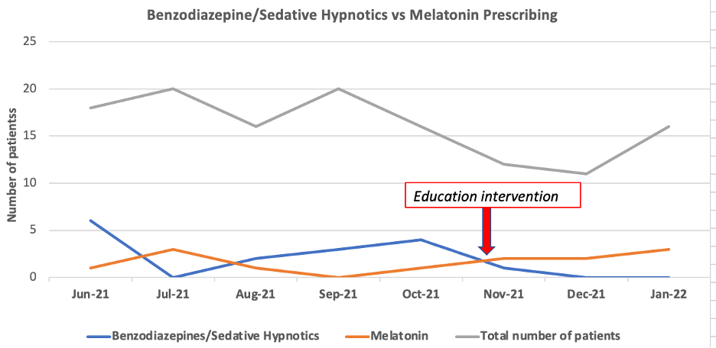
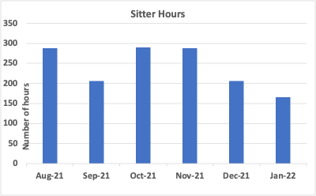
Decreasing the use of Benzodiazepines and Sedative Hypnotics in
post operative older adults
Amaka Opute DNP, APRN, ACNP-BC
UTSW Medical Center Dallas – DNPs of Color
Background
Prevalence rates of Benzodiazepines and Sedative hypnotics​
32% of adults >65years old are prescribed Benzodiazepines​
59% of adults >65years old with psychiatric disorders are prescribed Benzodiazepines​
25% of newly prescribed Benzodiazepines are continued 90days after discharge from the hospital​
Routine prescribing of Benzodiazepine and sedative hypnotics in older adults as first line for sleep has contributed to:​
Prolonged hospital stay​
Increased fall rates​
Increased development of delirium​
Increased use of patient safety sitters
Objectives
Decrease prescribing of Benzodiazepines and sedative hypnotics by 5% within​ 90days of project initiation​
Increase the prescribing of Melatonin as the first line for sleep
Methods
Quality improvement Project​
Pre and post test survey design​
Retrospective comparison of Benzodiazepines and Sedative hypnotics prescribing patterns​
Retrospective comparison of Melatonin prescribing patterns​
​
References or Qr Code
Al-Aama, T., Brymer, C., Gutmanis, I., Woolmore-Goodwin, S. M., Esbaugh, J., Dasgupta, ​
M. Melatonin decreases delirium in elderly patients: A randomized, placebo-controlled ​
trial. Int J Geriatr Psychiatry (2011) 26(7):687–94.10.1002/gps.258​
Najjar, M., Sulaiman, S. A., Aljeraisy, M., & Balubaid, H. (2018). The impact of a combined intervention program: An educational and clinical pharmacist’s intervention to improve prescribing pattern in hospitalized geriatric patients at King Abdulaziz Medical City in Riyadh, Saudi Arabia. Therapeutics and Clinical Risk Management,14, 557–564. doi: 10.2147/tcrm.s157469 ​
Intervention
Educational in-services for advanced practice providers, residents and nursing staff with focus on a)the adverse effects of benzodiazepine use amongst older adults b) Choosing wisely guidelines c) use of melatonin as a first line medication for sleep d) non pharmacologic measures of sleep promotion. ​
Continuous transparent prescribing monitoring of providers, coupled with further education for specific providers as deemed necessary.​
​
Measures &Analysis
Total # of patients prescribed Benzodiazepines and Sedative hypnotics monthly in the pre vs post implementation phase​
Total # of patients prescribed Melatonin in the pre vs post implementation phase​
Rate of delirium on the unit measured by # of patient safety sitter hours utilized​
Data Analysis​
Descriptive analysis and statistical analysis of the two data sets to monitor the impact of the intervention
Results
33% decreasing in prescribing of Benzodiazepine/sedative hypnotics​
12% increase in prescribing of Melatonin​
28% decrease in the use of patient safety sitter​
Next steps
Replication of this project on a different unit for a prolonged period with the initiation of a revised order-set that would replace benzodiazepine with melatonin using an electronic order set
Results
Implications
Educational intervention can be effective in changing prescribing practices amongst providers​
Similar approach could effectively change prescribers’ behavior over a period​practice. (
Conclusion
Provider education and nursing education, coupled with transparent monitoring of prescribing practices, decreased the prescription of benzodiazepines and sedative-hypnotics.

