Slide 1
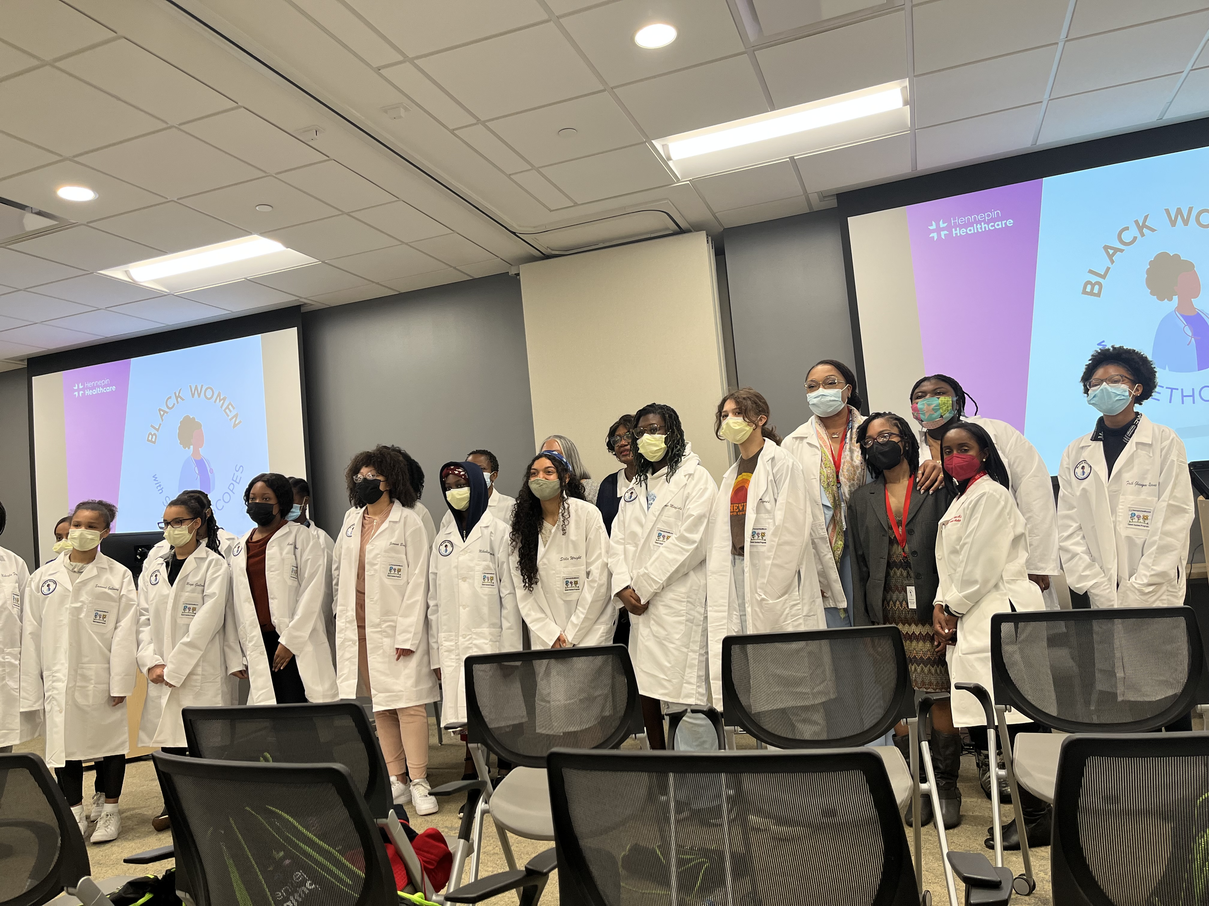
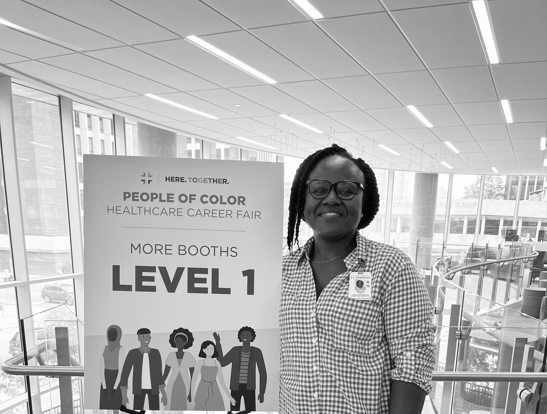
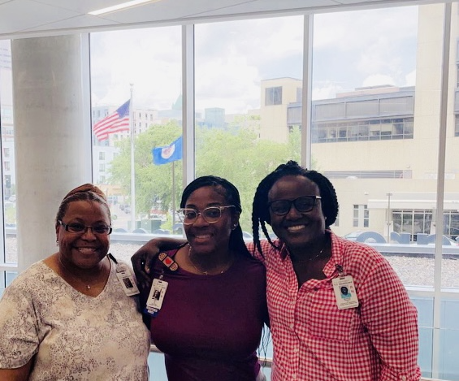
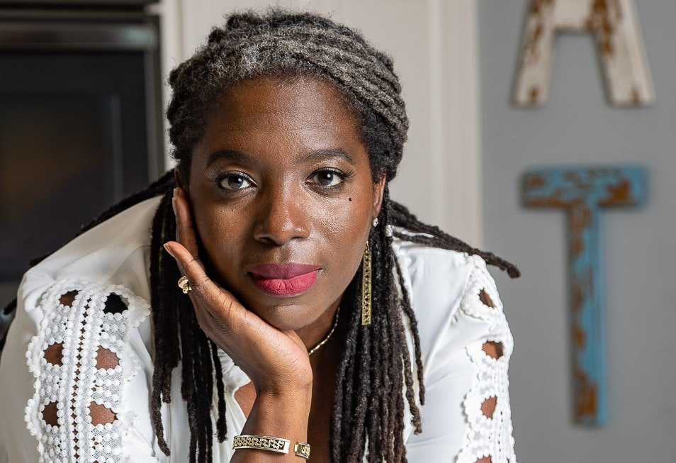
Partnering for health equity and reduction of disparities
Gertrude Brown Thomas DNP, MSN, BSN, RN
Hennepin Healthcare – DNPs of Color
University of Minnesota school of Nursing, Minneapolis, Minnesota State,
Background
Narrowing the gap in health equity and outcomes demands a new perspective.
In their 2021 document The Future of Nursing 2020-2030: The National Academies of Science, Engineering, and Medicine identify ways in which Nurses should work with the interdisciplinary team to eliminate disparities in healthcare and move towards equitable care delivery.¹
Partnership across disciplines backed by actions that deliver care with a focus on equity will bring us closer narrowing equity gap.²
Including communities in decisions that affect their outcome is yields results.³
Purpose: To evaluate Nursing knowledge & participation in DEI initiatives that affect equity outcomes in one healthcare setting
Outline work across discipline within a safety net healthcare system to promote equitable health outcome.
Assess level of nursing knowledge and participation in works to close the equity gap and decrease disparities in healthcare delivery.
Describe community involvement to improve health outcomes across a healthcare setting
Methods
Design: Qualitative study through interviews and
observation.
Setting: Safety net hospital Minneapolis, Minnesota
Sample: Leaders across disciplines, nursing staff and community members.
Observation through volunteering, collaboration and
direct interview
Tool: Interview questions from the American Hospitals Association Equity toolkit.⁴
Outcome: Gap in nursing knowledge and participation
of equitable initiative across the organization.
Analytic methods: Stratification of qualitative data
Results
Two 1:1 extensive interviews conducted with Nurse executive and DEI executive showed extensive work driven by the organization’s strategic plan to improve health equity and reduce disparities in health outcomes for the community is in focus.
Observation with notes from talent garden-black women in white coat initiative showed limited knowledge and participation of nurses from across the organization.
Volunteer-observation of community in people of color Health career fair & random interview of nurses showed limited knowledge/interest & participation in DEI the initiatives.
Implications
There is a high need for executives to form partnership with nurses (the largest sector of the healthcare workforce) beyond the executive level to make DEI initiatives a part of the organizations culture
Diversity, Education, and Inclusion (DEI) should be a focal point for cultural humility education across all levels of nursing curriculum.
Limitations
Limitations of the study is based on the observations and interviews carried on at one organization. This limits generalization of findings to all healthcare organizations.
The AHA tool on equity was structured and peer reviewed for adjustment to one setting. There was no test of internal validity of the interpretation of interview questions.
Next Steps
Interview with Chief Medical officer followed expansion of descriptive study to include 2 other organizations from Metro area hospitals over a two- year period.
Data stratification and publication.
References
American Hospitals Association (2011).Health research and educational trust. Improving health equity through data collection and use: A guide for hospital leaders. Chicago: Health Research & Educational Trust, 2011. https://www.aha.org/hretdisparities/toolkit
National Academies (2021). An Overview of Nursing’s Role in Addressing Health Equity -- The Future of Nursing 2020-2030 Webinar https://www.nationalacademies.org/our-work/the-future-of-nursing-2020-2030
National Academies (2021). Diversifying the Nursing Workforce to Advance Health Equity -- The Future of Nursing 2020-2030 Webinar https://www.nationalacademies.org/our-work/the-future-of-nursing-2020-2030
The National Academies (2021).The future of nursing 2020-2030: Charting a path to achieve health equity. Washington, DC: The National Academies Press. doi: 10.17226/25982. https://www.nationalacademies.org/our-work/the-future-of-nursing-2020-2030
Acknowledgements
Dr. Stephanie Gingerich, DNP, RN, CPN
Dr. Nneka Sederstrom PHD, MPH, MA
Kelly White, MSN, RN
Contact: thom7453@umn.edu@dnpsofcolor.org
Contact: thom7453@umn.edu@dnpsofcolor.org
Table 1. Leaders Perspective on DEI Partnership for equity
Questions from the AHA equity toolkit | Nursing leader perspective | DEI leader perspective
Where does the organization stand in progressing the call action in partnering for health equity | Still work to be done in nursing in the area of mentorship | Making changes through hiring & representation
Inclusion of leaders to reflect the community | Pockets of structural racism that we need to address | Outreach involvement-new leadership
Perspective on quality data stratification by race | Work in progress on analyzing data to impact change | Move from data collection to interventions
Perspective on Community involvement /projection | Focus on addressing quality outcomes by race presented through data collection | Community partnership: Bringing in community vendors
Perspective on cultural competence training | Need for bias training and trauma informed care education for nurses | Tackling on multiple fronts-onboarding, hiring practices. Ongoing education
Figure 1. Title. Black women in white coat-an observed initiative of the organization’s talent garden-powered by the DEI team, supported by volunteers across discipline
Figure 2. Observation at the people of color career health fair-an initiative of the people and culture department (formerly Human Resource). powered by volunteers from nursing and other disciplines.
Figure 3. The organization receives National accreditation for Health Equity from NCQA.
Conclusion:
Multiple initiatives to improve health equity and close the disparity gap is happening across the organization with minimal nursing involvement.
There is limited knowledge & participation from nurses in ongoing work to close the equity gap and reduce health disparities.
The community is ready for inclusion across discipline to improve health outcome.
Table 2. Participation and assessment of nurses’ knowledge in DEI partnership & works of equity
Events observed | Nurses of color participation | Nurse not identified as nurses of color participation
Talent garden initiative observed participation | <10% | <5%
Nurses’ knowledge of talent garden initiative | 25% | 10%
People of color career fair observed participation | <10% | <5%
Nurses knowledge of people of color career fair | 30% | 45%
Notes:
https://www.nationalacademies.org/our-work/the-future-of-nursing-2020-2030
Diversifying the Nursing Workforce to Advance Health Equity -- The Future of Nursing 2020-2030 Webinar 4
Health Research and Educational Trust. Improving Health Equity Through Data Collection AND Use: A Guide for Hospital Leaders. Chicago: Health Research & Educational Trust, 2011.

